Slide 1

Adventure Alley

Slide 2
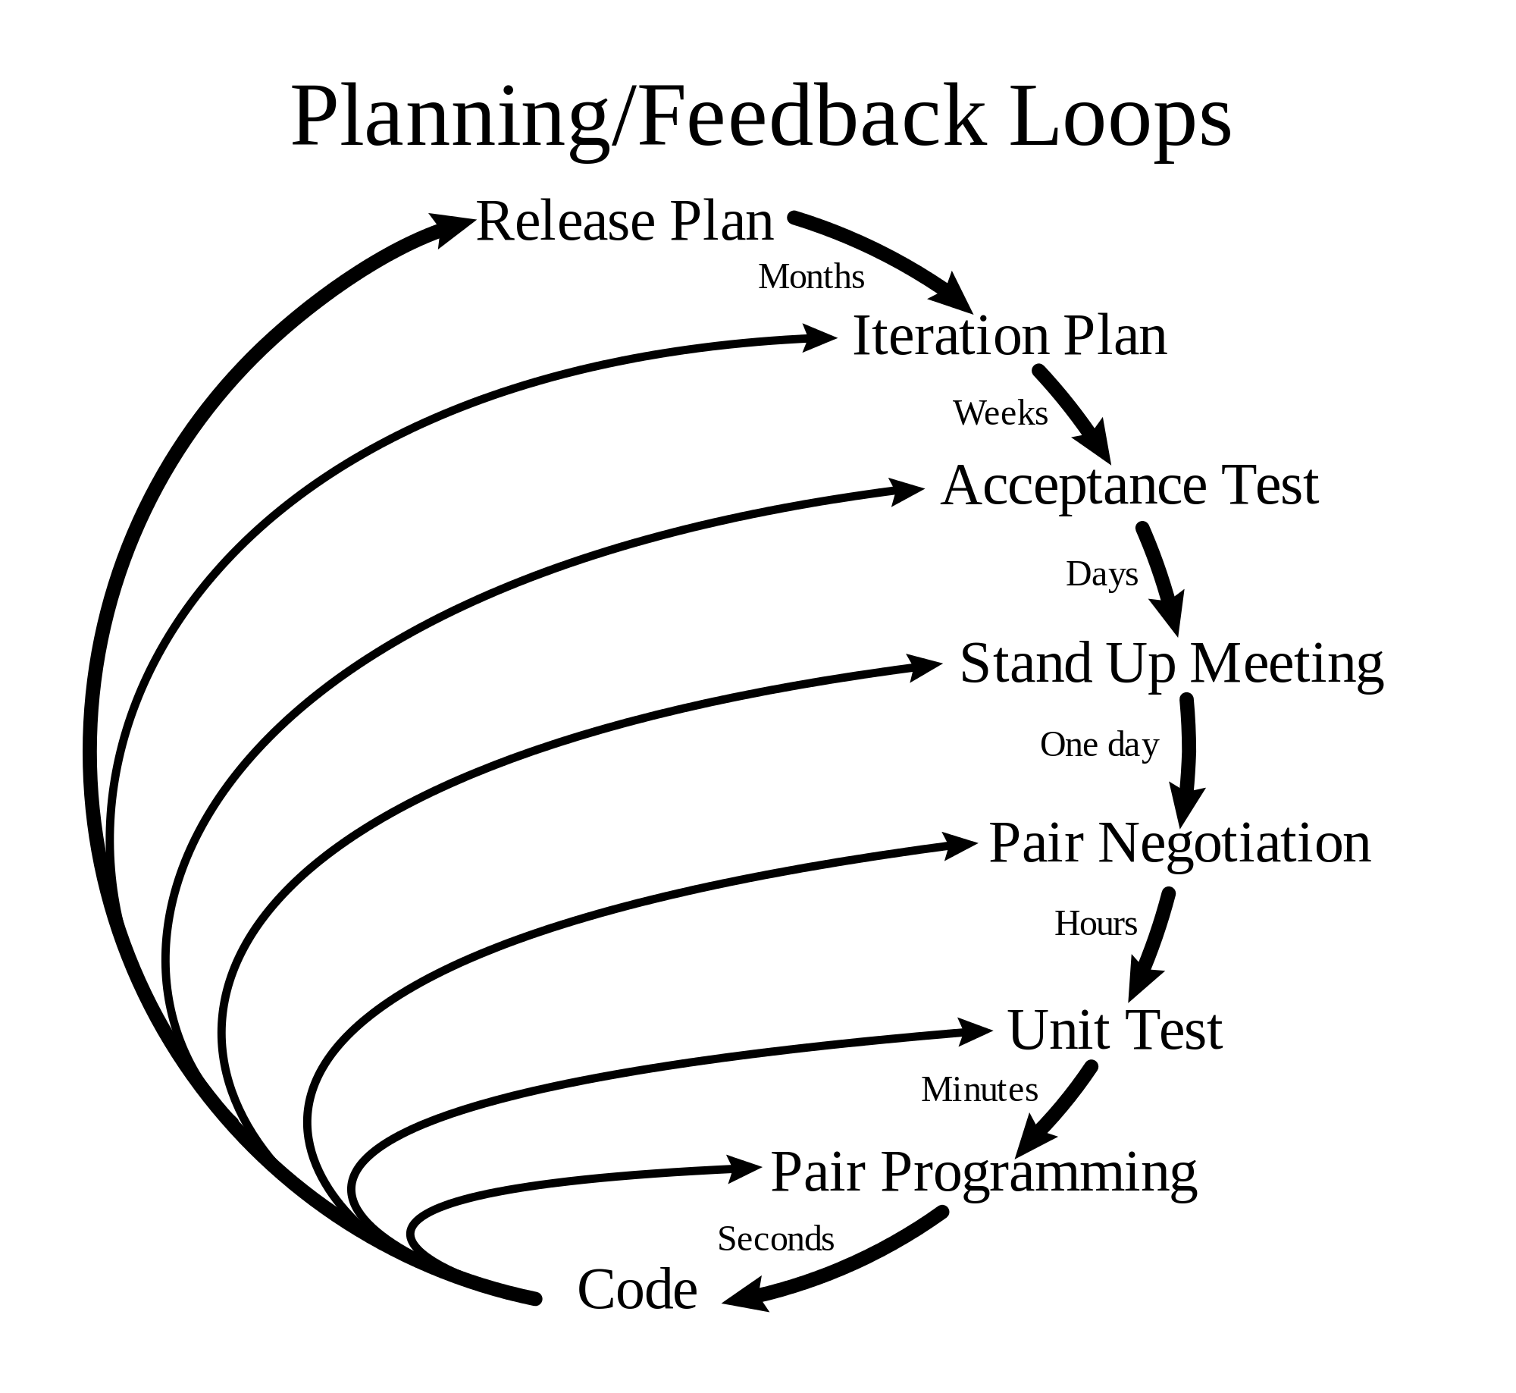
The Process

Slide 3

Design Process
Text
Received Customer Requirements
Derived User Stories
Added Tasks to Trello
In teams of two, members grab a card and begin working on it

Slide 4

Pair Programming
Text
Efficient
Less Bugs
Bounce Ideas off of one another

Slide 5
Code Review
Text
We did informal Code Reviews
Used Circle CI
Github Pull Requests tell us if the branch can be pulled into master without conflict
What we should do next time:
More formal code reviews
Having another pair review the code

Slide 6
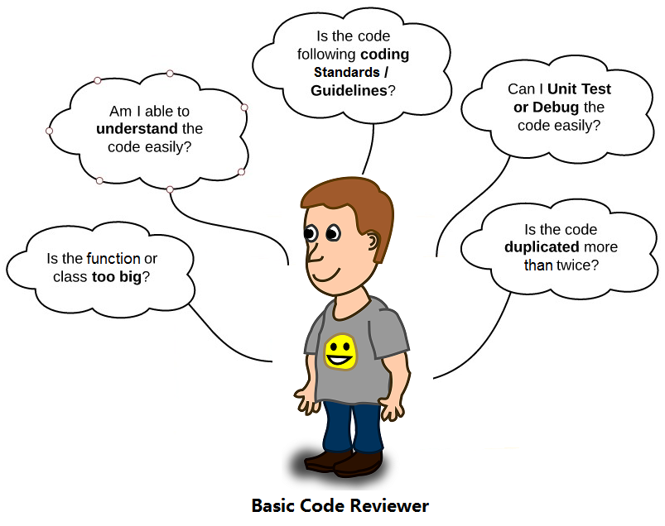

Slide 7
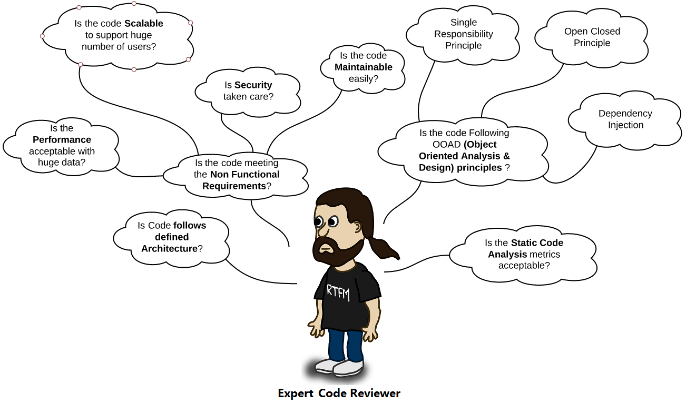

Slide 8
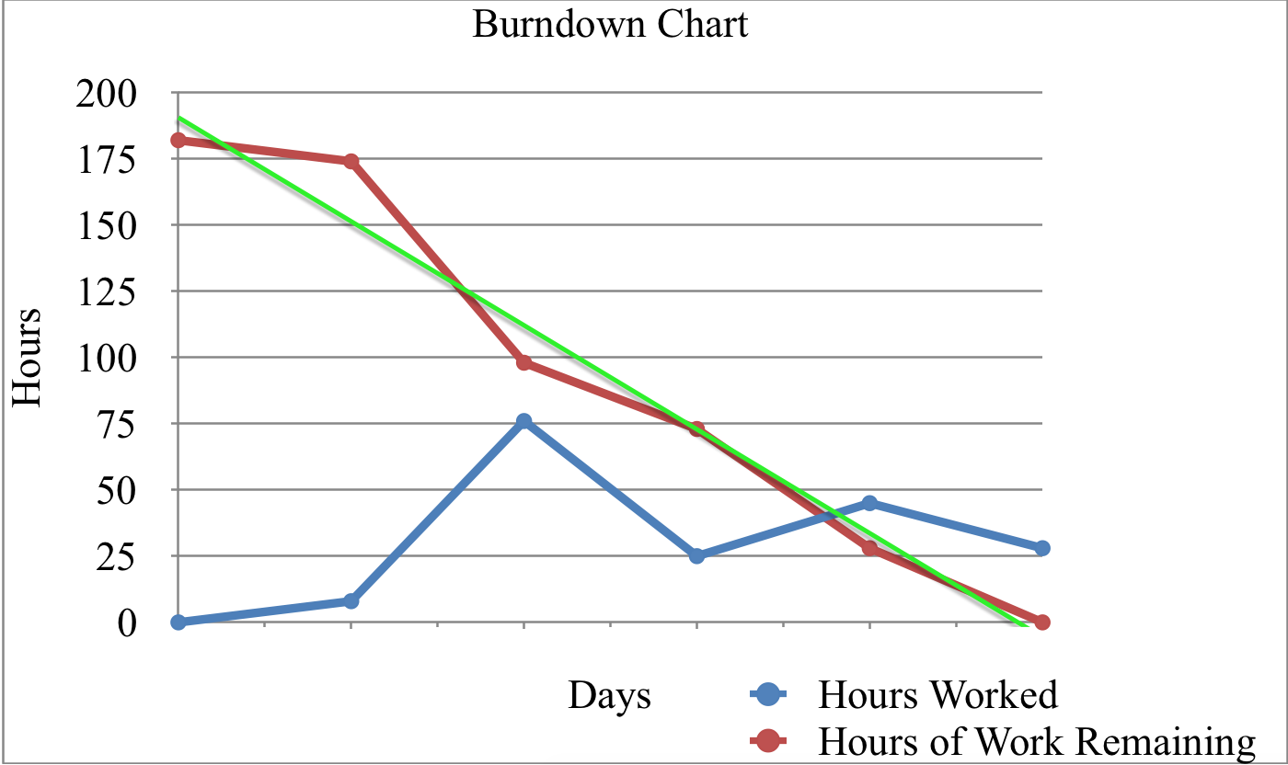
Burn baby burn
Work work work

Slide 9
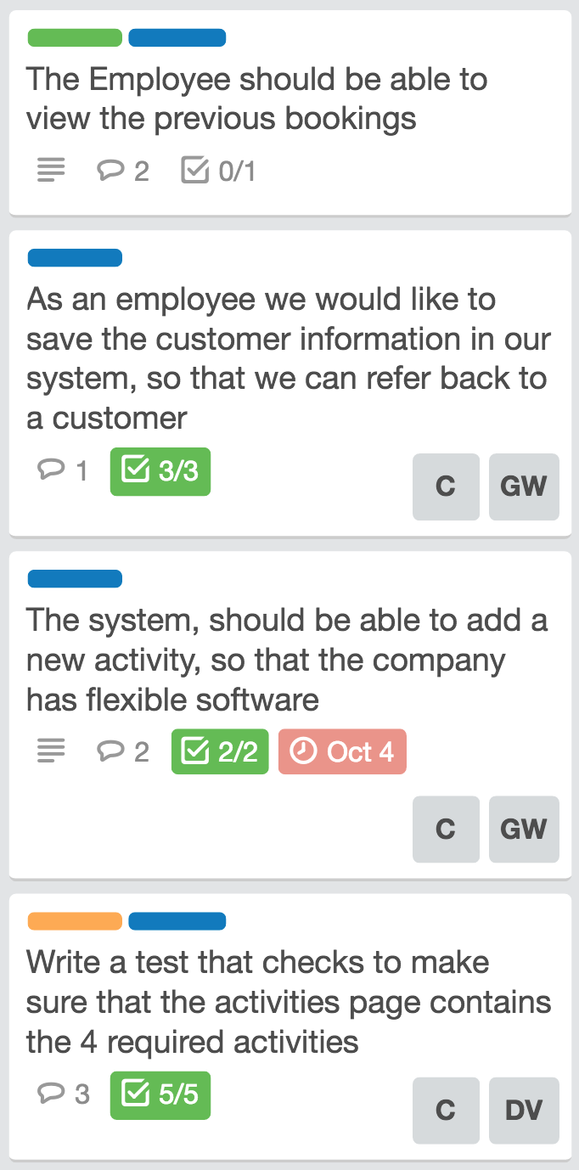
Getting Started
XP Programming
Project Requirements Defined
User Stories created
Trello Board, Slack, Github

Slide 10

Testing
Text
The Testing Suite
Selenium
JUnit
Circle CI
Why?
XP is test Driven

Slide 11
Missing Functionality
Its just a Prototype
Cannot Cancel A booking
Cannot Search a booking
Cannot Limit a person to participate by Age
Data is not permanently Stored
No Total Price on the Booking Overview
No Dates

Slide 12
Full Transparency

Slide 13
Application Demo

Slide 14
